Slide 1
Geog 10001: The Geography of Scarcity Hydrology
Dr. Brian Cook
School of Geography
brian.cook@unimelb.edu.au

Slide 2
Today we will cover…
Summarise last class
Water
Physical processes and physical geography
The goal
Understanding water processes, issues, and governance so that we can talk about water scarcity.

Slide 3
Essay question and deadline
Third essay due May 20
Question is:
With reference to different framings of scarcity discussed in class, analyse Kerr’s (2012) criticism of technological ‘fixes’ in the context of agricultural change in Africa.
Kerr, R. B. 2012. Lessons from the old Green Revolution for the new: Social, environmental and nutritional issues for agricultural change in Africa. Progress in Development Studies 12(2-3): 213-229.
Final exam.
Changed due date from June 9th to June 16th.
Will allow us to mark the third essay and get you feedback for the final.

Slide 4
REVIEW FROM LAST CLASS

Slide 5
Key point 1
No ‘Truth’, but lots of truths (bounded rationality)
Scarcity cannot (and should not) be understood, explained, or managed using single interpretation (i.e. production, economics, entitlements).
“whether different analytical frameworks should be invoked to explain different famines, depending on the configuration of causal factors in each case” (Deveraux 2007: 7).

Slide 6
Key point 2
Commission & Omission
Famines are associated with specific political regimes (colonial, military, autocratic).
Conflicts connected to famines (disrupt trade, used as a tool).
Global relations (World Bank demands for economic reform leading to famines; sanctions in Iraq).
No global accountability for famine response (often a product of publicity and chance.

Slide 7
Sen
(Sangeetha)
Rather than a progression from one dominant interpretation to the next, it is the gradual accumulation of concepts and interpretations that allow us different vantages on issues.
Malthus
(Simon)
Modern
(Brian)

Slide 8
SOLAR RADIATION & THE ENERGY BALANCE

Slide 9
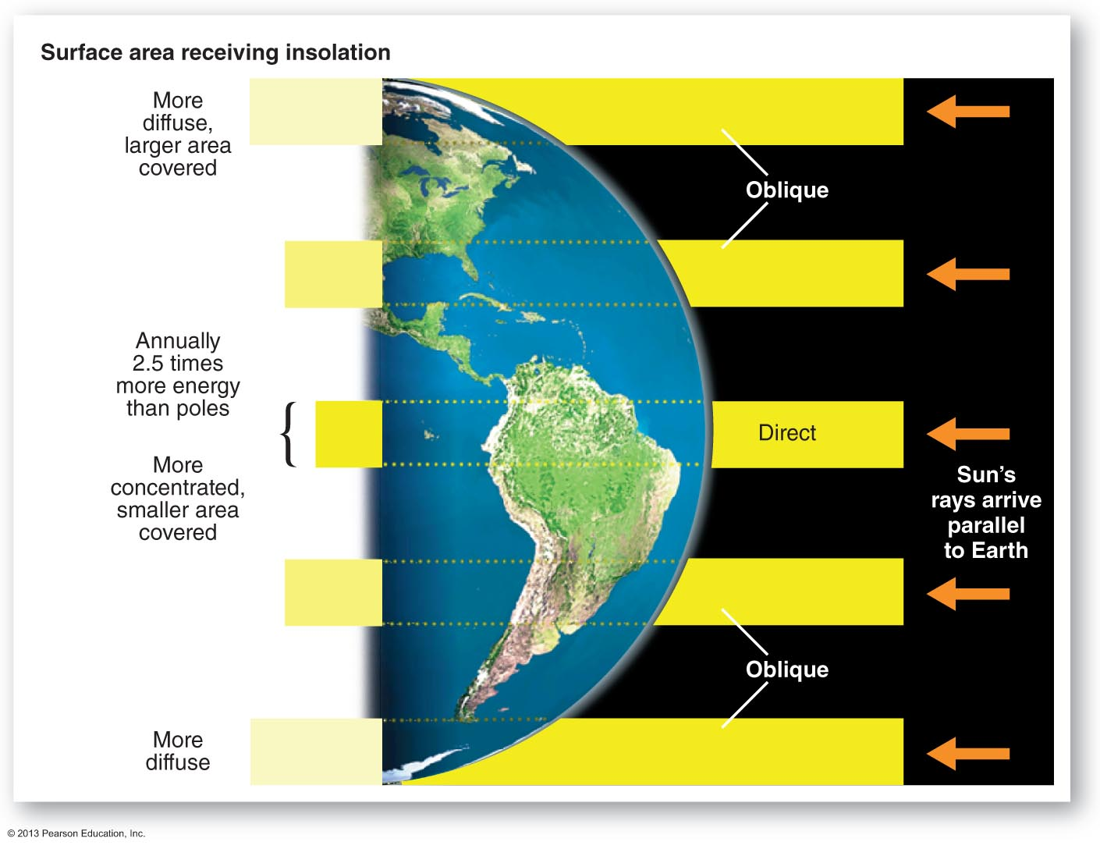
Incoming Solar Radiation

Slide 10
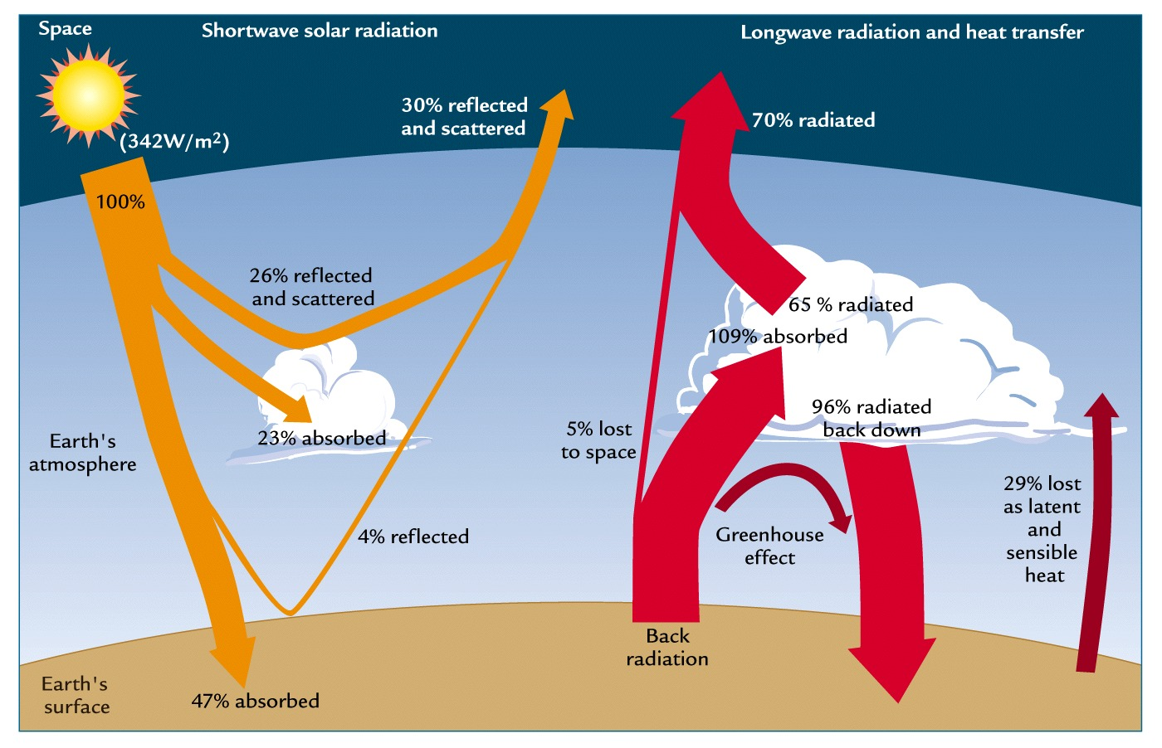
Energy Balance

Slide 11
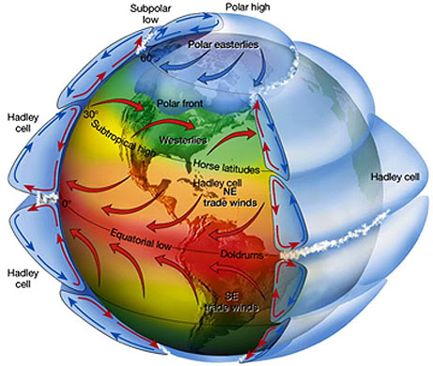
Atmospheric Cycle

Slide 12
PHYSICAL GEOGRAPHY: WATER

Slide 13
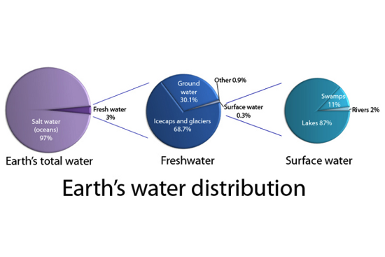
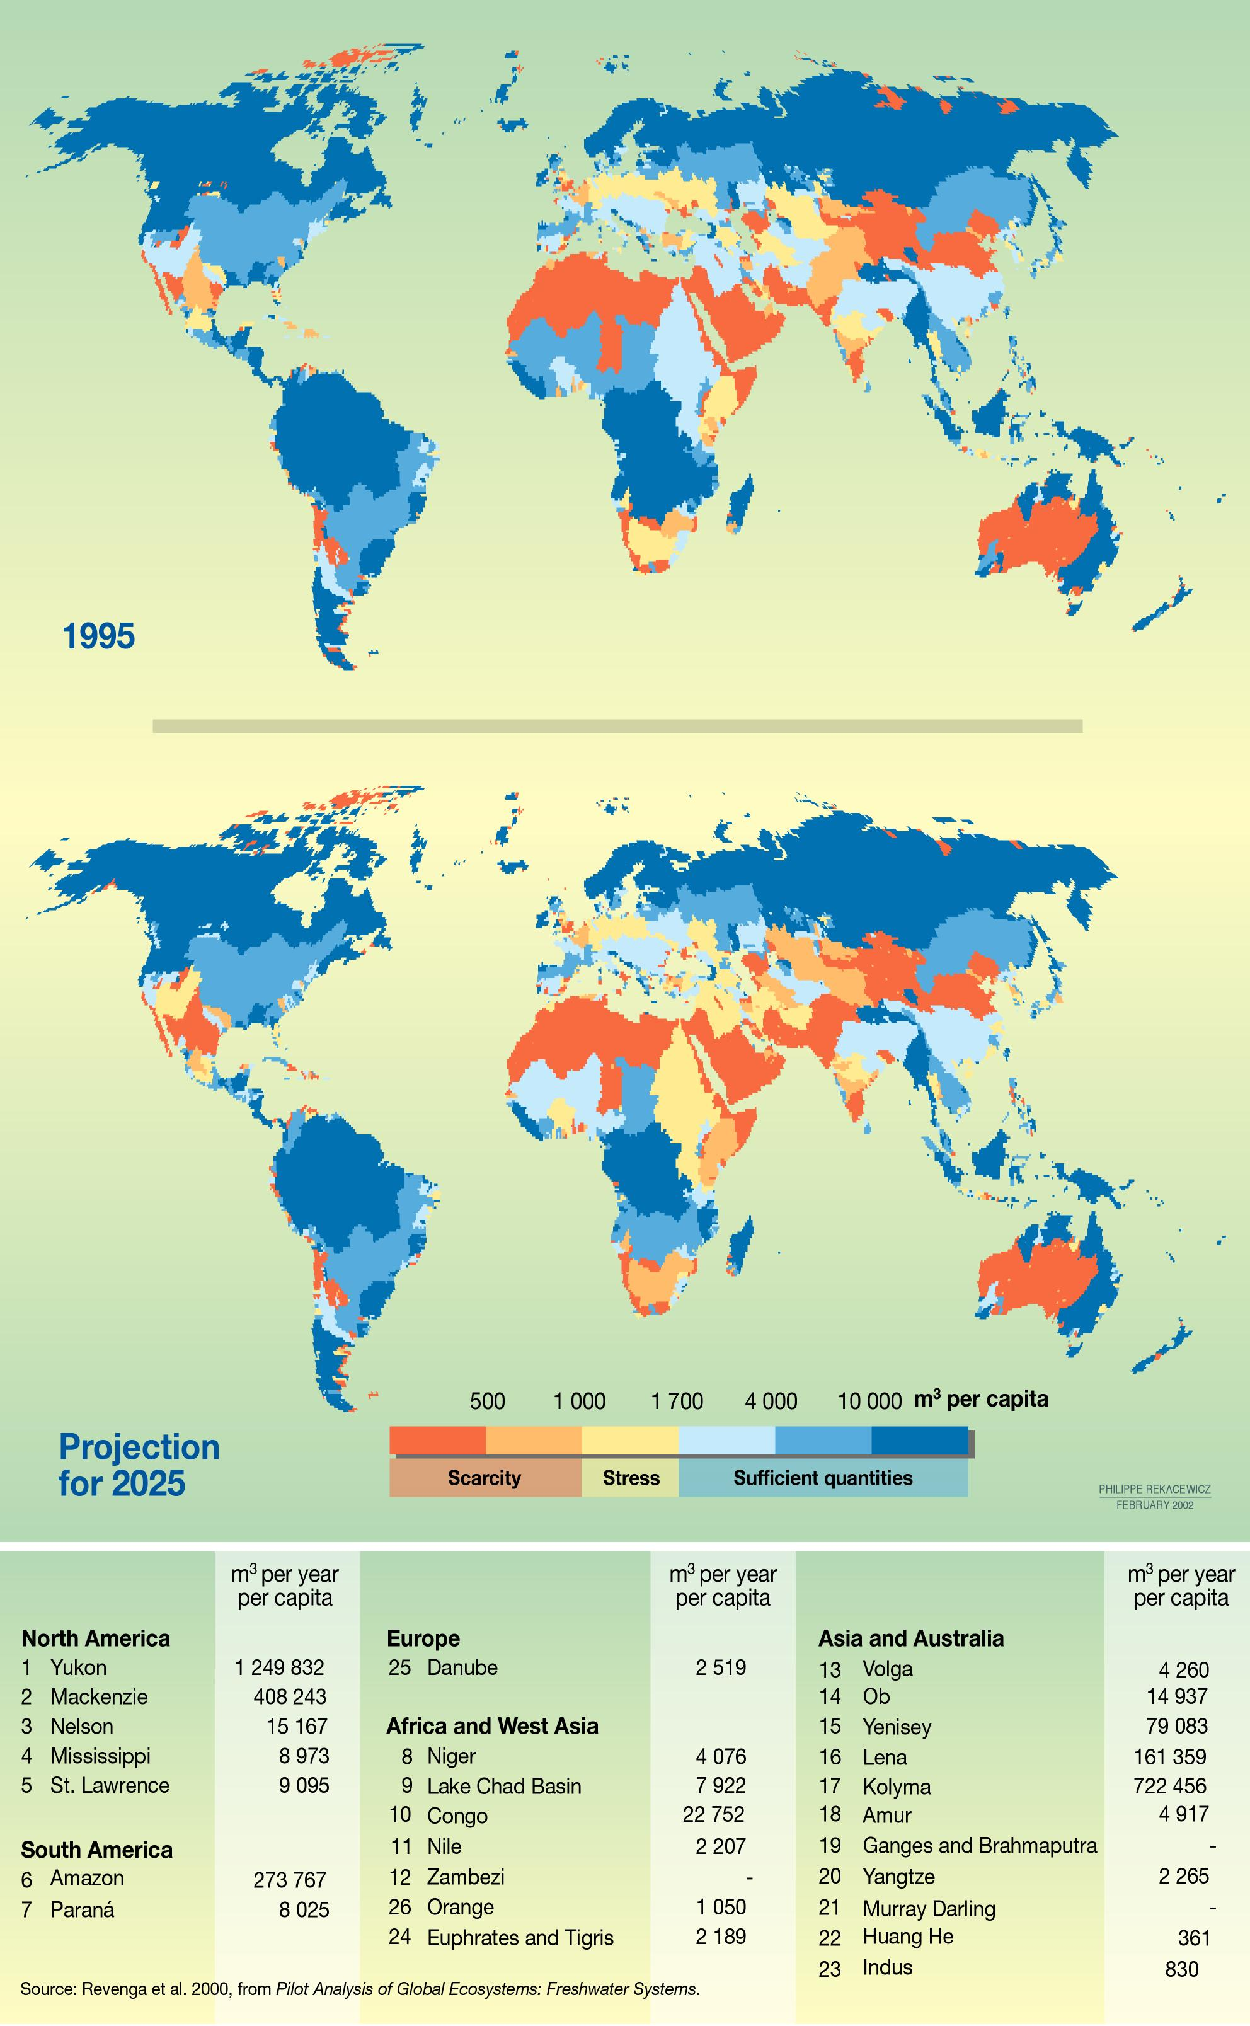
Freshwater – is it really scarce?

Slide 14
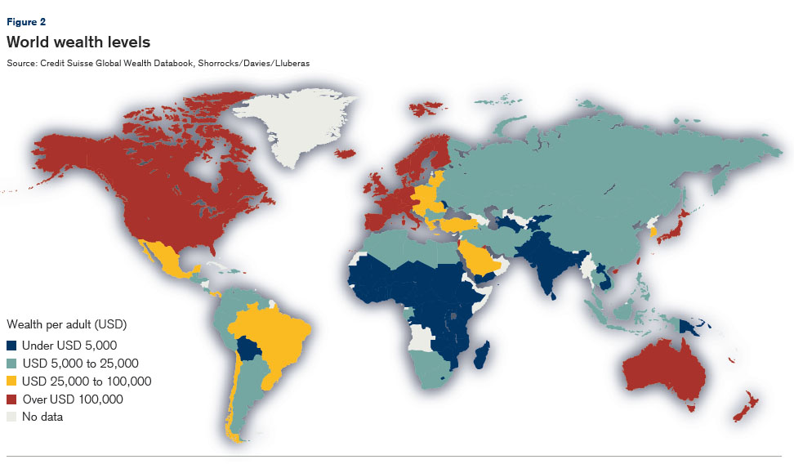
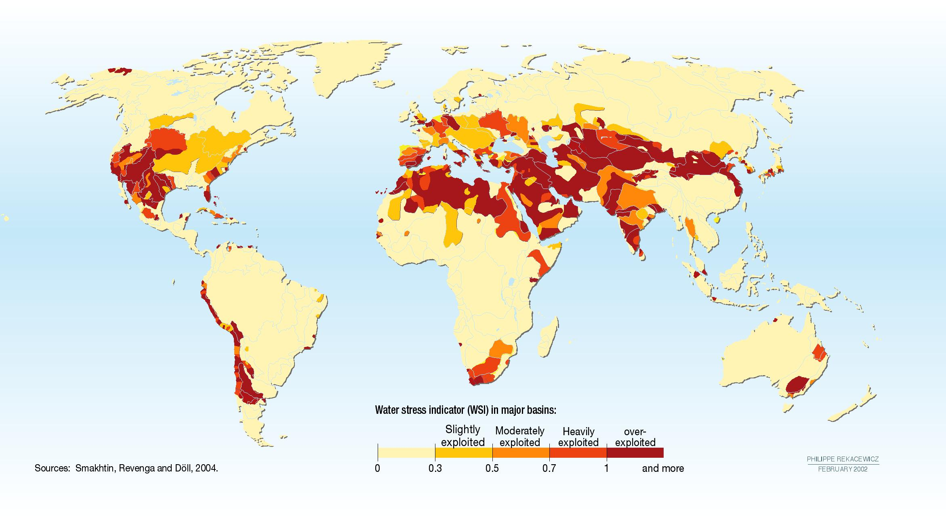

Slide 15
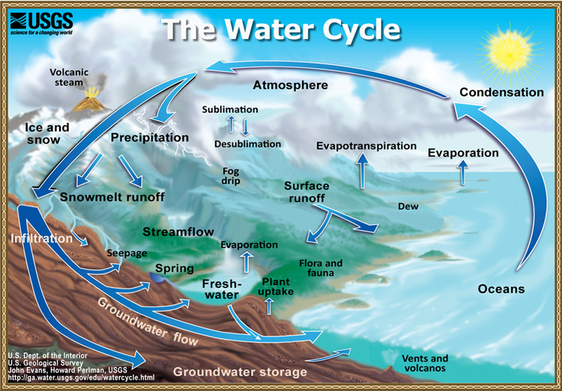
Water Cycle

Slide 16
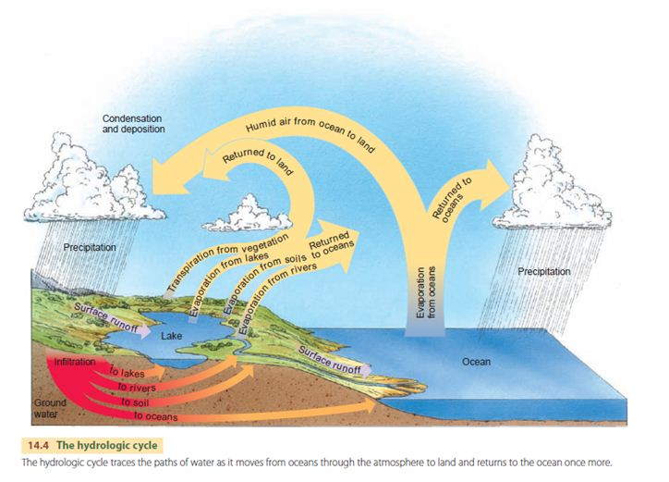
Where precipitation goes

Slide 17
Water Cycle: what we need to know…
Infiltration
Runoff
Overland flow
Saturation
Precipitation

Slide 18
GROUND WATER

Slide 19
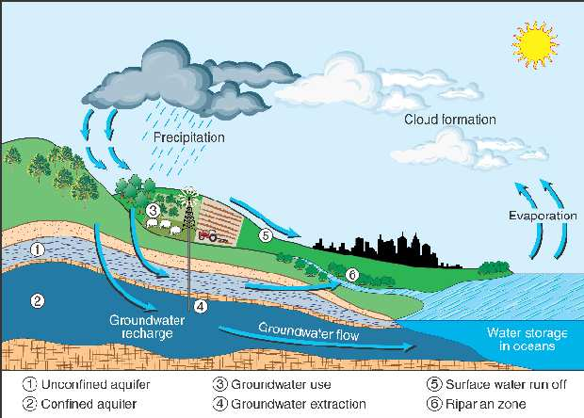
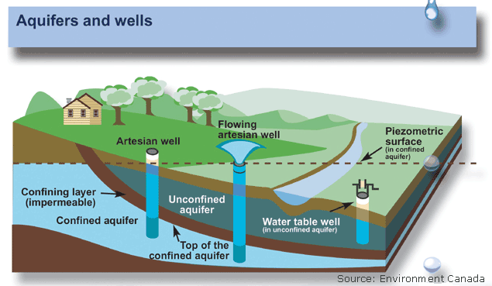
Aquifers and Wells
What happens to runoff and infiltration?

Slide 20
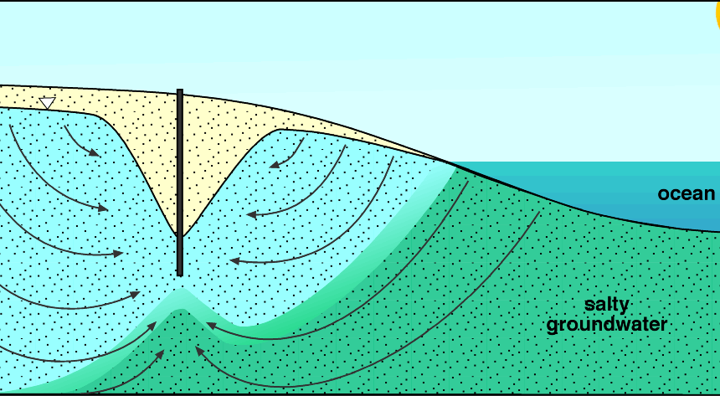
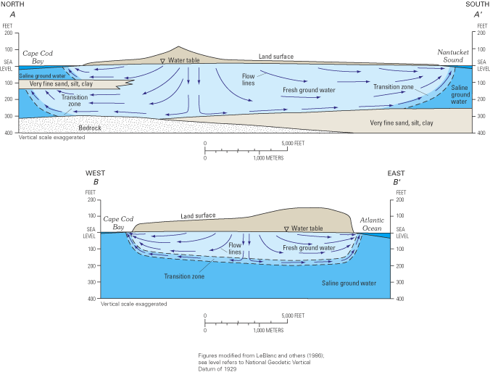
Saline Intrusion

Slide 21
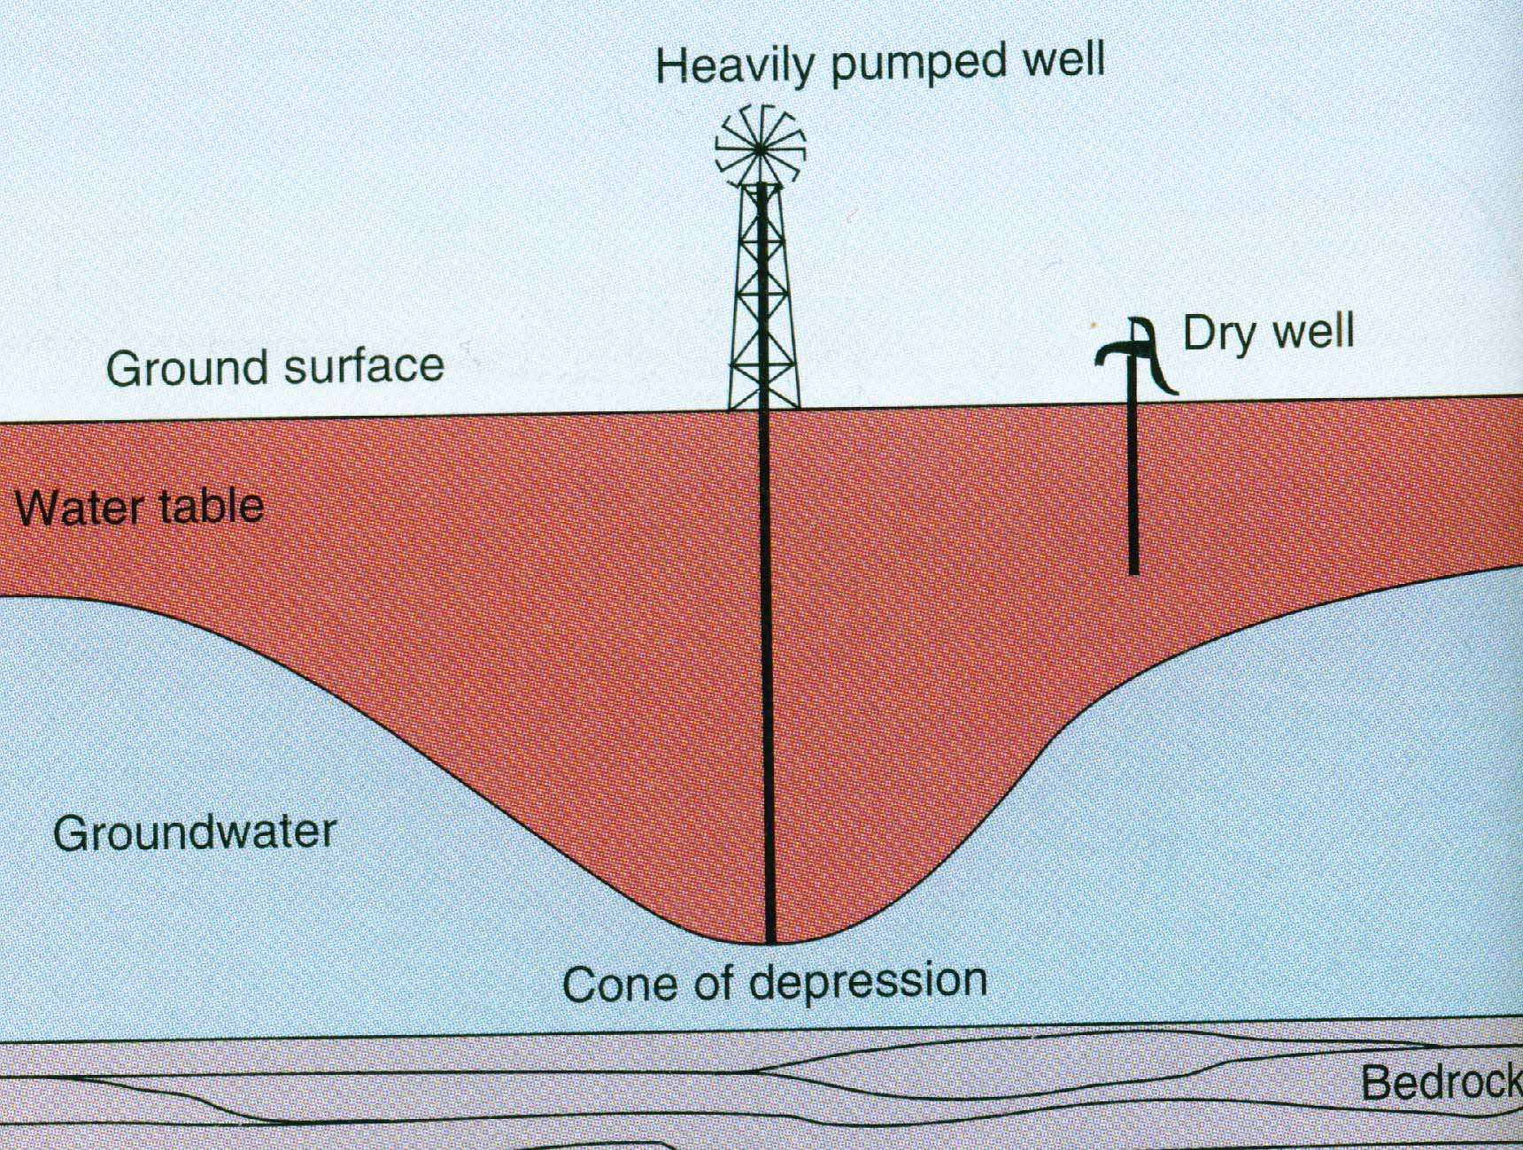
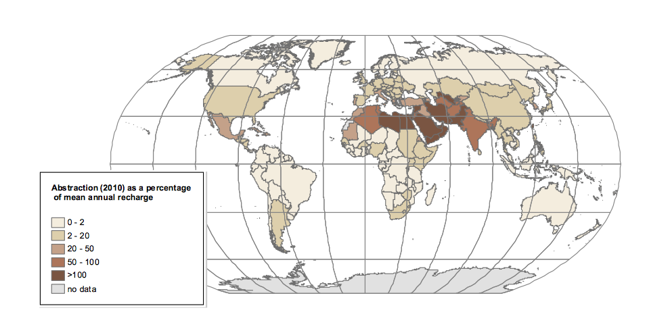
Conflict over ground water
Different wells draw different amounts and are ‘sunk’ to different levels

Slide 22
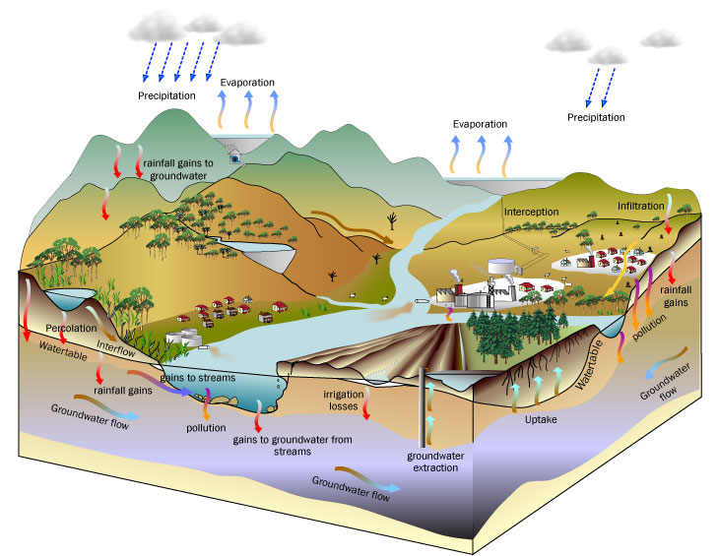
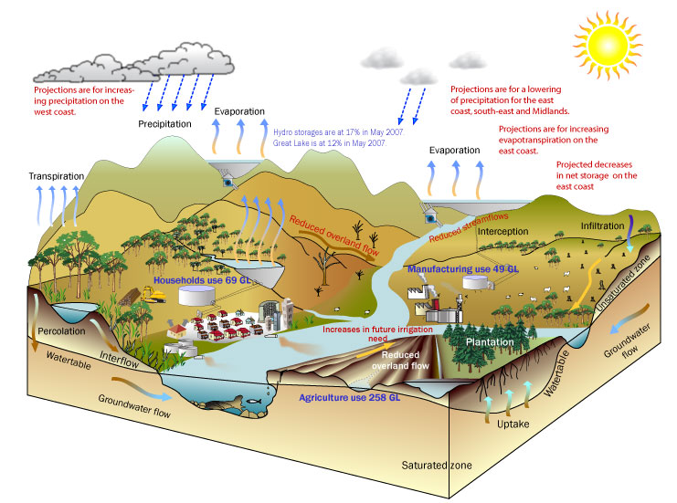
Water cycle and pollution

Slide 23
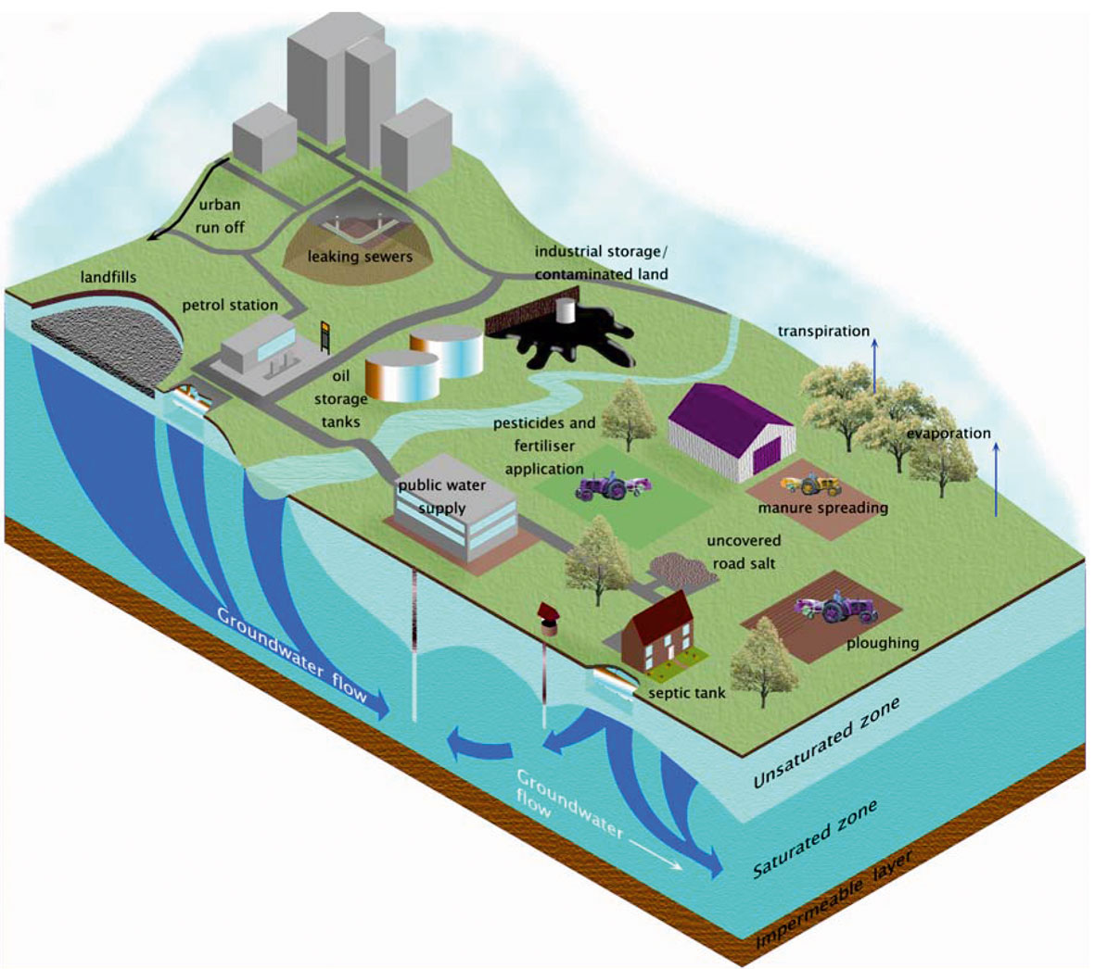
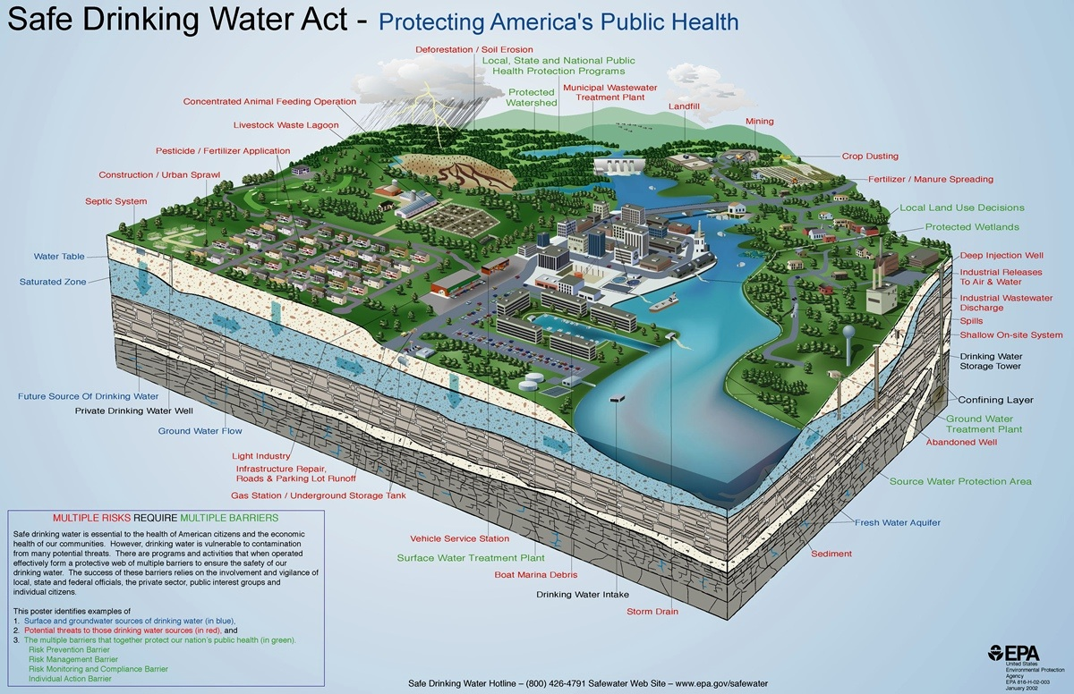
Groundwater and pollution

Slide 24
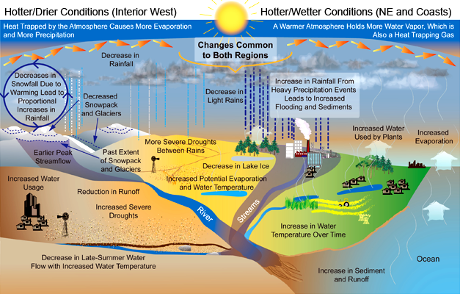
Water cycle and climate change

Slide 25
ENERGY, WATER, & EROSION

Slide 26
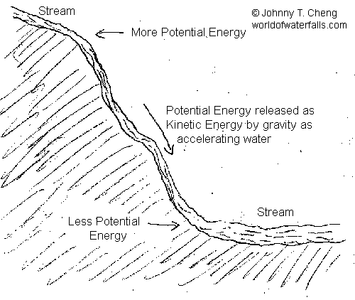
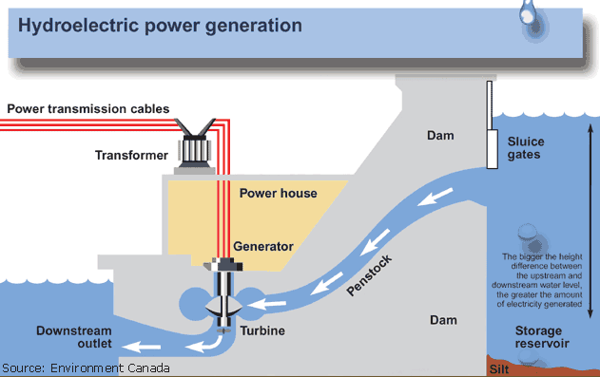
Energy (potential & kinetic)
This has huge implications for water management because of hydro power.

Slide 27
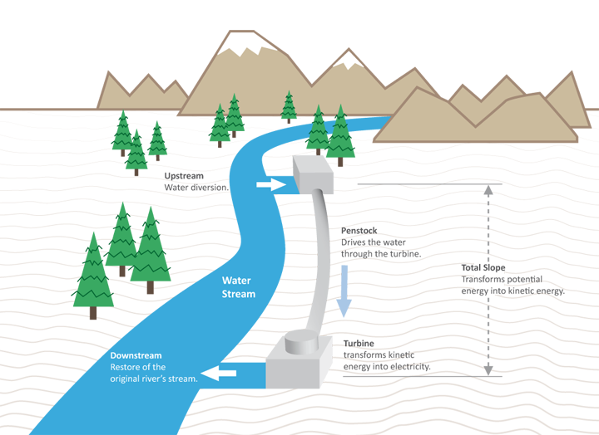
Run of river hydro
The dream is to move from traditional ‘dams’ to ‘run-of-river hydro.
What might be an implication of this transition?

Slide 28
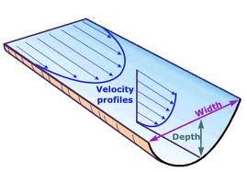
Stream Velocity
Where is the river flowing fastest?

Slide 29
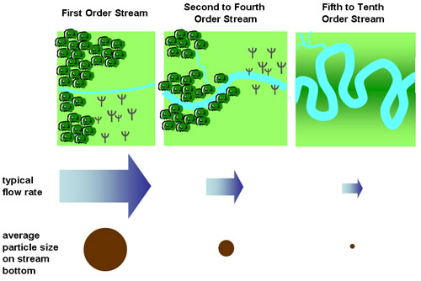
Erosion
Faster flow = larger particle transfer

Slide 30
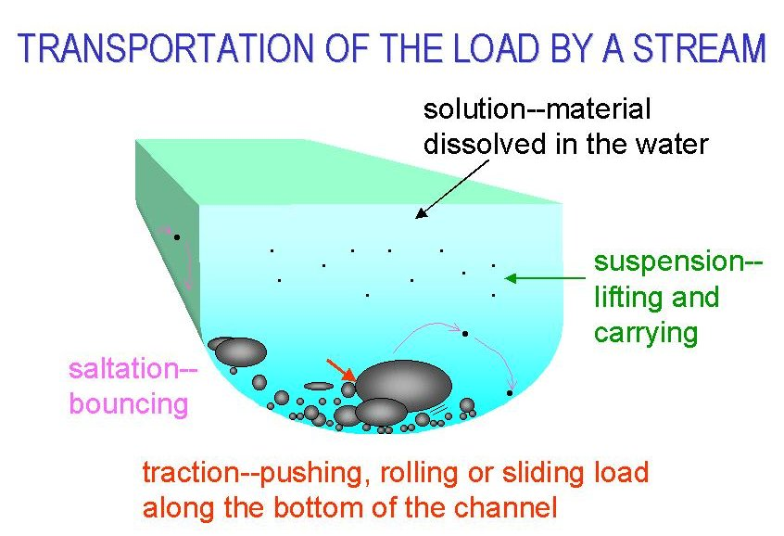
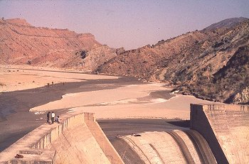
Sediment Transport
What are the implications for river damming and reservoirs?

Slide 31
SUMMARY & CONCLUSION

Slide 32
Key point 1
Hydrological cycle
Hydrological processes
Runoff, infiltration, erosion, sediment transport, saline intrusion,

Slide 33
Next Class
Integrated Water Resource Management (IWRM)
Cases of water management.
I’ll be using the concepts from today to discuss the cases and then begin relating IWRM to scarcity. Please be sure that you understand the concepts covered today.

Slide 34
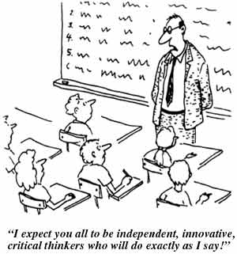
Questions or Concerns
Questions?

Slide 35
Sources & Further Reading
Chorley, R.J., Kennedy, B.A. (1971) Physical geography: a systems approach. Prentice-Hall London.
Christopherson, R.W., Hall, P., Thomsen, C.E. (2012) Introduction to Physical Geography. Montana.
Christopherson RW, Hall P and Thomsen CE. (2012) Introduction to Physical Geography. Montana.
Harrison S, Massey D, Richards K, et al. (2004) Thinking across the divide: perspectives on the conversations between physical and human geography. Area 36: 435-442.
Kearnes MB. (2003) Geographies that matter--the rhetorical deployment of physicality? Social & Cultural Geography 4: 139-153.
Lane SN. (2001) Constructive comments on D Massey - 'Space-time, "science" and the relationship between physical geography and human geography'. Transactions of the Institute of British Geographers 26: 243-256.
Massey D. (1999) Space-time, 'science' and the relationship between physical geography and human geography. Transactions of the Institute of British Geographers 24: 261-276.
Pattison I and Lane SN. (2011) The link between land-use management and fluvial flood risk: A chaotic conception? Progress in Physical Geography 36: 72-92.
Poesen JWA, Hooke JM, Lane SN, et al. (1997) Erosion, flooding and channel management in Mediterranean environments of southern Europe
Surveillant Science: Challenges for the Management of Rural Environments Emerging from the New Generation Diffuse Pollution Models. Progress in Physical Geography 21: 157.
Serra P, Pons X and Sauri D. (2008) Land-cover and land-use change in a Mediterranean landscape: A spatial analysis of driving forces integrating biophysical and human factors. Applied Geography 28: 189-209.

